Slide 1
Project Training III
User story
MAITRE Robin, VAILLANT Yann, GALAN Guillaume, OHLAND Emmanuel, CAO Yuguo,

Slide 2
Summary
Customer story cards
Restaurant story cards
System Architecture

Slide 3
Customer story cards
Story card Title : Find my friends Estimate : 2 day Priority : 1
User Story: As a customer, I would like to know where are my friends for inviting them to eat.
Acceptance test criteria : Send your position to the server Receive the distance of my friends
Note : Use Google API for location

Slide 4
Customer story cards
Story card Title : Find restaurants around Estimate : 2 day Priority : 1
User Story: As a customer, I would like to know if the restaurant is far and how to go there.
Acceptance test criteria : Find restaurants around the user Use google map to go to the restaurant
Note : The backend will find restaurants positions with the Google API and store it on the database.

Slide 5
Customer story cards
Story card Title : Food suggestion Estimate : 1 day Priority : 1
User Story: As a customer, sometimes I would like to have some advices for find a restaurant and food.
Acceptance test criteria : Create personal suggestions based on history choice
Note : none

Slide 6
Restaurant story cards
Story card Title : Food hit parade Estimate : 1 day Priority : 1
User Story: As a restaurant manager I would like to know which dish my customers prefer.
Acceptance test criteria : Statistics of food
Note : None

Slide 7
Restaurant story cards
Story card Title : Send promotion Estimate : 1 day Priority : 1
User Story: As a restaurant manager I would like to send some promotions to my customers.
Acceptance test criteria : Receive promotions
Note : Google push service

Slide 8
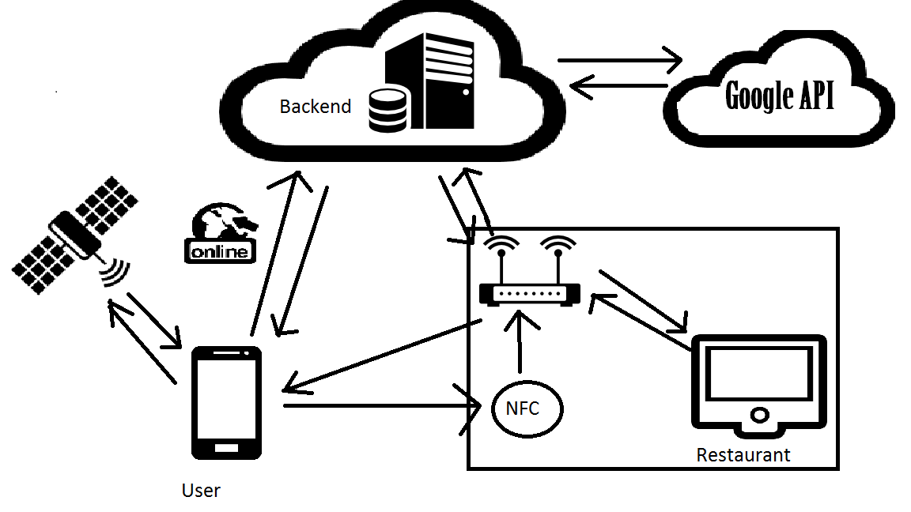
System Architecture

